Slide 1


Slide 2

CONTENTS
BUSINESS OBJECTIVE
BUSINESS CONSTRAINTS
PROJECT WORKFLOW
PROJECT ARCHITECTURE
DATA COLLECTION
DATA PREPROCESSING
KEY CHALLENGES
CONCLUSION

Slide 3
BUSINESS PROBLEM
A leading steel manufacturer is facing challenges in accurately determining the most efficient steel grades based on energy consumption, production speed, and overall productivity. The absence of precise classification limits their ability to optimize manufacturing processes, streamline operations, and achieve cost savings.
Business Objective:Maximize Product Efficiency.

Slide 4
OBJECTIVE:
Maximize Product Efficiency.
CONSTRAINT:
Minimize the energy consumption and cycle time.

Slide 5
PROJECT WORKFLOW
CRISP-ML(Q) Methodology
There are six stages of CRISP-ML(Q) Methodology
1.Business and data understanding
2.Data preparation
3.Model building
4.Model evaluation
5.Model deployment
6.Monitoring and maintenance

Slide 6
PROJECT ARCHITECTURE

Slide 7
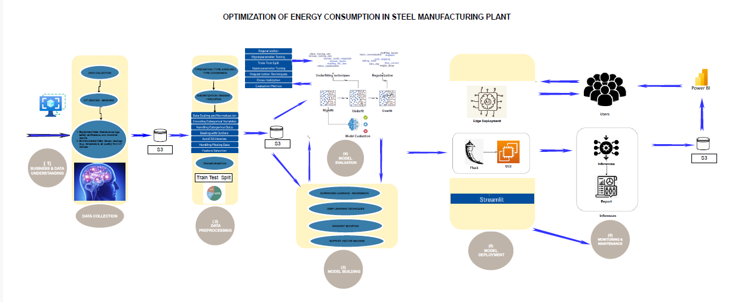
PROJECT ARCHITECTURE-HIGH LEVEL

Slide 8
Technical Stacks:
Programming: Python, SQL
Data Manipulation: Pandas, NumPy.
Data Visualization: Matplotlib, Seaborn
Machine Learning: Scikit-leam, XGBoost
Model Evaluation: Accuracy, Confusion Matrix, Classification Report Tools.
Frameworks: Jupyter Notebook Google Colab
Deployment: Streamit

Slide 9

Data Dictionary
COKE_REQ: Quantity of coke required for the production process (continuous numerical).
SCRAP QTY: Quantity of scrap used in the process (continuous numerical).
INJ1_QTY: Quantity of coke injection in the blast furnace (continuous numerical).
PIGIRON: Amount of pig iron produced (continuous numerical).
KWH_PER_TON: Energy consumption per ton of production (continuous numerical).
KWH_PER_MIN: Energy consumption per minute (continuous numerical).
TAPPING_TIME: Timestamp when the tapping process starts (datetime).

Slide 10
POW_ON_TIME: Timestamp when the power-on process starts (datetime).
LAB_REP_TIME: Timestamp when the lab report is generated (datetime).
GRADE: Steel grade produced (categorical: quality specification of steel).
SECTION_IC: Section of the production process (categorical: e.g., different stages or areas).
MELT TIME: Time taken for melting the material (continuous numerical).

Slide 11
HOT_METAL: Amount of hot metal produced (continuous numerical).
Production (MT): Total production in metric tons (continuous numerical).
PREV_TAP_TIME: Timestamp for the previous tapping process (datetime).
VARIOUS OTHER VARIABLES: Additional features related to operational and chemical data (e.g., C, SI, MN- chemical compositions).

Slide 12
Data Collection:
Production Data: Includes material quantities (COKE REQ SCRAP QTY), energy consumption (KWH_PER_TON, KWH PER MIN), and time-related variables (TAPPING TIME, POW ON TIME).
Operational Data: Includes hot metal production (HOT METAL) and steel grade (GRADE). Chemical Composition: Data on key materials like C, SI, and MN.
External Factors: Weather and shift data influencing production.
Time-based Data: Timestamps (TAPPING TIME, POW ON TIME) for time-series analysis.

Slide 13
Data Understanding:
EDA: Visualizing production trends, identifying outliers, and understanding feature distributions
Data Cleaning: Handling missing values (mode for categorical, mean for numerical) and addressing outers. Key Factors: Identifying factors like shift timing, material quality, and energy consumption affecting production.
-Correlation Analysis: Analyzing relationships between features to uncover key drivers of production efficiency.

Slide 14
Data Information:
-Source: Data provided by the client (company's past steel manufacturing data)
-Data Dimensions: Rows: 2,059 Columns: 79
-Key Features: CSV
-Material Quantities: COKE REQ SCRAP QTY. INJ1 QTY, PIGIRON, etc.
-Energy Usage: KWH PER TON, KWH PER MIN, ENERGY, etc.
-Time-related Variables: TAPPING TIME. POW ON TIME. LAB_REP_TIME, etc.
-Chemical Compositions: C, SI, MN, etc.
-Production Information: Production (MT), MELT TIME. HOT METAL, etc.
-Time Period: Data spans from [01/08/2023] to [31/10/2023]

Slide 15
System Requirements
Hardware:
Processor: Multi-core (Intel i5/i7 or AMD Ryzen 5/7) •Memory (RAM): 8 GB (Recommended: 16 GB) Storage: 500 GB HDD (Recommended: 1 TB SSD)
•Graphics Card (GPU): Integrated (for basic tasks), NVIDIA GTX 1660 or equivalent (for deep learning)
Software:
Operating System: Windows 10/11, Linux (Ubuntu preferred)
Programming: Python 3.x, R (optional)
Libraries: Pandas, NumPy, Scikit-learn, XGBoost,
Data Visualization: Matplotlib, Seaborn, Plotly, Tableau/Power BI Notebooks/IDE: Jupyter Notebook, Google Colab, VS Code, PyCharm Databases: SQL (PostgreSQL/MYSQL)
Cloud Storage: AWS S3, Google Cloud Storage (optional)

Slide 16
Exploratory Data Analysis [EDA]
Statistical Insights:
1.Right-Skewed Distributions:
Features like SCRAP QTY and HOT METAL are positively skewed, with a concentration of values on the lower end and a long tail on the higher end.
2.High Variance &amp; Outliers:
ENERGY and MELT TIME show high variance, primarily due to extreme outliers that cause substantial deviation from the mean.

Slide 17

3.Weak Correlation:
There is some weak correlation between features like COKE_REQ and SCRAP_QTY, but the relationship appears non- linear, suggesting complexity in the data.
4.Kurtosis:
Several variables, such as PIGIRON and HBI, show high kurtosis, indicating the presence of heavy tails or outliers.
Business Insights:
1.Material Usage Optimization: Outliers in INJ1_QTY and SCRAP QTY suggest opportunities to optimize material usage and reduce waste.
2.Energy Efficiency: High variance in ENERGY indicates potential for cost reduction by improving energy consumption practices.

Slide 18
3. Production Efficiency: Weak correlation between COKE_REQ and SCRAP QTY highlights the need for independent optimization of both.
4. Quality Control: Outliers in HOT METAL and PIGIRON suggest improving consistency in production to enhance product quality.
5. Process Stability: High variance in MELT TIME points to process instability, which can be addressed to improve predictability and efficiency.

Slide 19
Missing Values Observation
Missing Data:
LAB_REP_TIME: 29 missing (forward-filled) PREV_TAP_TIME: 3 missing (backward-filled)
Production (MT): 1 missing (median imputed)
Imputation Strategy:
Categorical Features: Mode imputation.
Numerical Features: Forward-fill, backward-fill, and median imputation for appropriate columns.
Reason:Mode for categorical to preserve common categories.
Median/Fill for numerical to maintain distribution and time continuity.
Impact:
Missing values handled without data loss or significant distortion.

Slide 20
Data Preprocessing:
Missing Values: Imputed categorical data with mode and numerical data with median or forward/backward fill.
Outliers: Detected using IQR and capped at valid boundaries.
Variable Transformation: Applied log and square root transformations to handle skewed data.

Slide 21

Scaling: Used RobustScaler to scale numerical features, ensuring robustness to outliers.
Encoding: One-hot encoded categorical features like GRADE and SECTION_IC.
Feature Engineering: Created time-based features (year, month, day) and calculated time differences (e.g., pow_on_to_tap_diff).

Slide 22
Model Building:
Introduction-
Multiple models were evaluated to classify data into two classes. XGBoost was chosen for its high performance.
Models Tested-
Logistic Regression, SVM, Random Forest, Gradient Boosting, AdaBoost, KNN, Decision Tree, Naive Bayes, Ridge Classifier, XGBoost.
Key Findings-
XGBoost: Best performance with 97.09% test accuracy, balanced precision and recall, and low overfitting. Other models like Random Forest and Gradient Boosting were strong contenders but didn’t outperform XGBoost.
Final Model-
XGBoost was selected due to its top performance and efficiency.

Slide 23
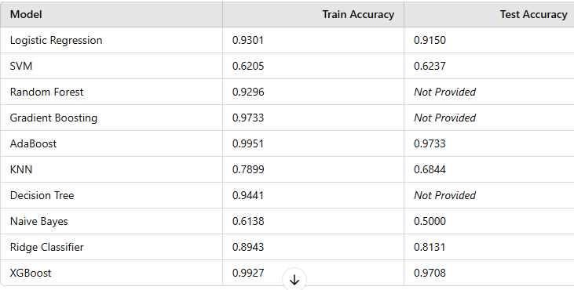

Slide 24
Key Challenges in Steel Manufacturing Operations:
Fluctuating Demand:
Steel grade demand varies due to market conditions, customer requirements, and production schedules. Without accurate demand prediction, resources may be underutilized or production may fail to meet demand, causing inefficiencies.
Operational Costs:
Mismanagement of resources, including labor, energy, and raw materials, leads to high operational costs. Overstaffing or understaffing, along with inefficient production of low-demand steel grades, increases expenses.
Environmental Impact:
Steel production is energy-intensive. Inefficient scheduling and resource usage contribute to excess fuel consumption and higher CO2 emissions, hindering sustainability goals.

Slide 25
5. DEPLOYMENT CHALLENGES (STREAMLIT)
LATENCY ISSUES: REAL-TIME OBJECT DETECTION MAY SLOW DOWN DUE TO LARGE IMAGE SIZES.
USER-FRIENDLY INTERFACE: ENSURING A SIMPLE AND INTERACTIVE UI FOR NON-TECHNICAL USERS.
INTEGRATION WITH EXISTING SYSTEMS:
MANY COMPANIES HAVE LEGACY SAFETY MONITORING SYSTEMS THAT NEED SEAMLESS INTEGRATION.

Slide 26
6. BUSINESS & ECONOMIC CHALLENGES
ADOPTION RESISTANCE: EMPLOYEES MAY RESIST AI-BASED MONITORING DUE TO PRIVACY CONCERNS.
COST CONSTRAINTS: BALANCING MODEL ACCURACY WHILE KEEPING DEPLOYMENT AND MAINTENANCE COSTS LOW.
REGULATORY COMPLIANCE: ENSURING THAT AI MONITORING ADHERES TO WORKPLACE SAFETY REGULATIONS AND LABOR LAWS.

Slide 27

IF YOU HAVE ANY QUESTIONS OR NEED FURTHER CLARIFICATION, FEEL FREE TO ASK.
PROJECT LEAD: HARSHIT GAUTAM
PRESENTED BY:MANDEEP SINGH THAKUR

